Slide 1
CYPRESS COLLEGE NURSING PROGRAM ADVISORY COMMITTEE MEETING
April 30, 2021

Slide 2
Curriculum Review
Four Semesters
Nursing Courses (8 Weeks Sessions)
Pharmacology In Nursing I-IV
1st Semester
Fundamentals of Nursing Introduction to Med/Surg and Gero Nursing
2nd Semester
Med/Surg Nursing I Maternal/Newborn Nursing
3rd Semester
Med/Surg Nursing II Mental Health Nursing (4 weeks)
Geriatric Nursing (4 weeks)
4th Semester
Child/Family Nursing Med/Surg Nursing III

Slide 3
Student Learning Outcomes
Evaluated in every nursing course
Clinical Experience-Student Learning Outcomes Evaluation Tool
Safety
Employ practices to ensure safety of patients and improve outcomes of care in the (medical/surg-pediatric-mental health) environment
Patient Centered Care
Advocate for patients, recognizing the patient or designee as the source of control an as a full partner in providing compassionate and coordinated care based on respect for patient’s preferences, values and needs.

Slide 4
Student Learning Outcomes
Teamwork and Collaboration
Collaborate effectively within nursing and inter-professional teams, fostering open communication, mutual respect and shared decision-making to achieve safe, quality patient care.
Evidenced-Based Practice
Use nursing judgement based on best current evidence to provide safe basic care for patients and families

Slide 5
Student Learning Outcomes
Quality Improvement
Apply principles of quality improvement to monitor the outcomes of care and minimize risk of harm to patients and providers.
Informatics
Use information technology to communicate, document care, minimize error and support decision making.

Slide 6
Student Learning Outcomes
Oxygenation, Regulation and Movement
Utilize best practices and sound nursing judgement to address oxygenation issues, maintain regulation and guide movement in patients in the medical-surgical environment.
Professionalism
Demonstrate professionalism in the implementation of the role of the Registered Nurse.

Slide 7
End of Program Student Learning Outcomes
Evaluated 4th Semester - Final/Senior Course
EPSLO #1: Employ practices to ensure safety of patients and improve outcomes of care.
NLN Comprehensive Nursing Achievement for RN Exam, Graduate Surveys, Employer Surveys
EPSLO #2: Advocate for patients, recognizing the patient or designee as the source of control and as a full partner in providing compassionate and coordinated care based on respect for patient’s preferences, values, and needs.

Slide 8
End of Program Student Learning Outcomes
EPSLO #3: Collaborate effectively within nursing inter-professional teams, fostering open communication, mutual respect, and shared decision making to achieve safe, quality patient care in a variety of healthcare settings.
EPSLO #4: Use nursing judgment based on best current evidence to provide safe care for patients and families across the lifespan.
EPSLO #5: Apply principles of quality improvement to monitor the outcomes of care and minimize risk of harm to patients and providers.

Slide 9
End of Program Student Learning Outcomes
EPSLO #6: Informatics - Use information and technology to communicate, document care, minimize error, and support decision making.
EPSLO #7: Utilize best practices and sound nursing judgement to address oxygenation issues, maintain regulation, and guide movement in patients across the lifespan.
EPSLO #8: Demonstrate professionalism in the implementation of the role of the registered nurse.

Slide 10
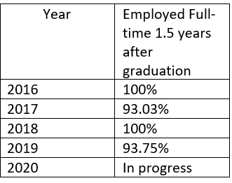
PROGRAM OUTCOMES
Job Placement/Employment Rates

Slide 11
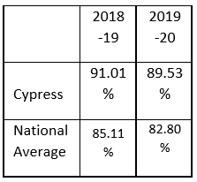
PROGRAM OUTCOMES
NCLEX Exam Passage Rates

Slide 12
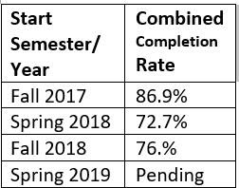
PROGRAM OUTCOMES
Program Completion/Graduation Rates

